Slide 1
Unit tests using JUnit and coverage analysis
DETI-UA/TQS
Ilídio Oliveira (ico@ua.pt)
v2025-09-17

Slide 2
Learning objectives
Explain the concept of the “test pyramid”
Describe the 3 main layers in the test pyramid
Identify relevant unit tests for a given contract
Enumerate best practices for unit testing
Write unit test using JUnit constructions
Analyze code coverage
Discuss spectrum-based fault location techniques

Slide 3
Verification vs Validation
VERIFICATION: ARE WE DOING THE SYSTEM IN THE RIGHT WAY?
Check work products against their specifications
Check modules consistency
Check against industry best practices
...
CORRECTNESS
VALIDATION: ARE WE DOING THE RIGHT SYSTEM?
Check work-products against the user needs and expectations
ACCEPTANCE

Slide 4
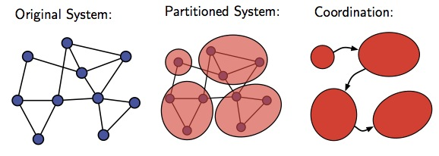
Different testing techniques are appropriate at different moments/scopes
  Does the program satisfy the requirements?
Unit testing
Each module does what it is supposed to do?
User Acceptance testing
integration
testing
Developer vs customer
managing complexity
  Do you get the expected results when the parts are put together?
System testing
  The whole system functions as expected, in the target config?
Integration
testing

Slide 5
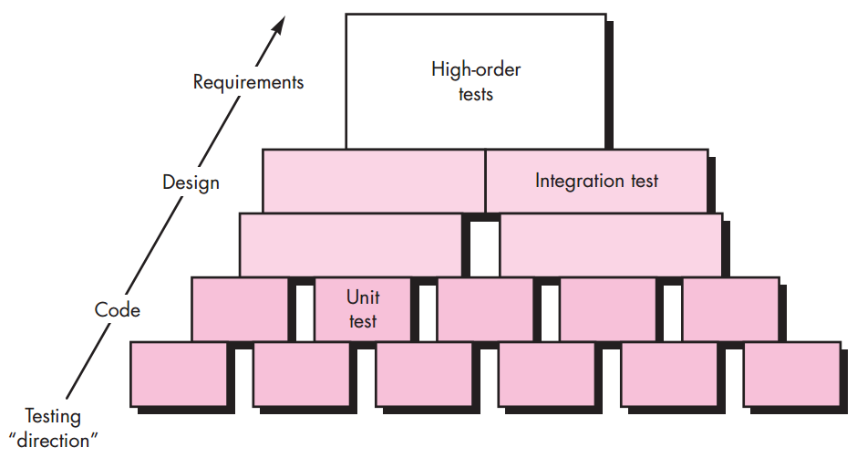
Testing begins at “celular” level and works outwards.

Slide 6
Which “scope”?
The Dice class should provide random draws.
The EmployeeManager service should list monthly top performers
The visitor will search by free text in the product browsing page.
Is the API handling timeouts from the online micro-payment services?

Slide 7
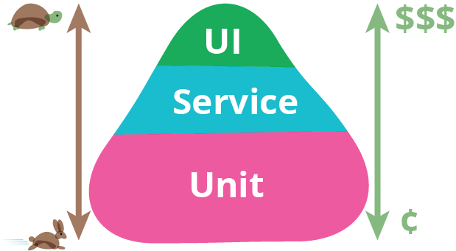
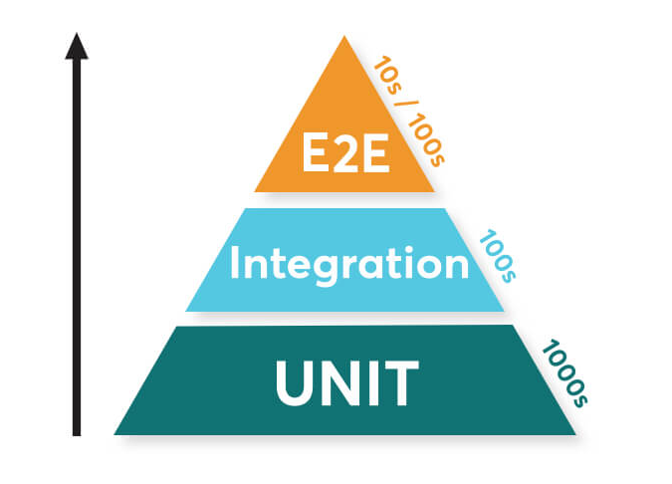
The test pyramid metaphor
https://martinfowler.com/bliki/TestPyramid.html

Slide 8
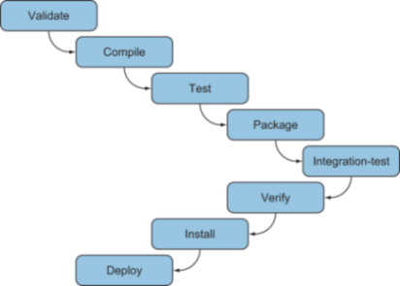


Maven build cycle and tests
Maven surefire plugin
Maven failsafe plugin

Slide 9
Role of Unit testing
Test “components” individually
  focused and concise tests
  Answers the question: does the component function correctly, in isolation?
What is a “component”, in this context?
  A basic build block, often a single class.
  Typically implemented by a single developer.
Strategy
  Exercise different paths in a component’s control structure
  Aim at ↑ coverage
  must integrate in build tools (e.g.: Maven can run tests and report results)

Slide 10
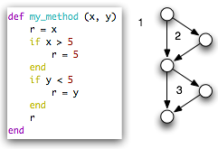
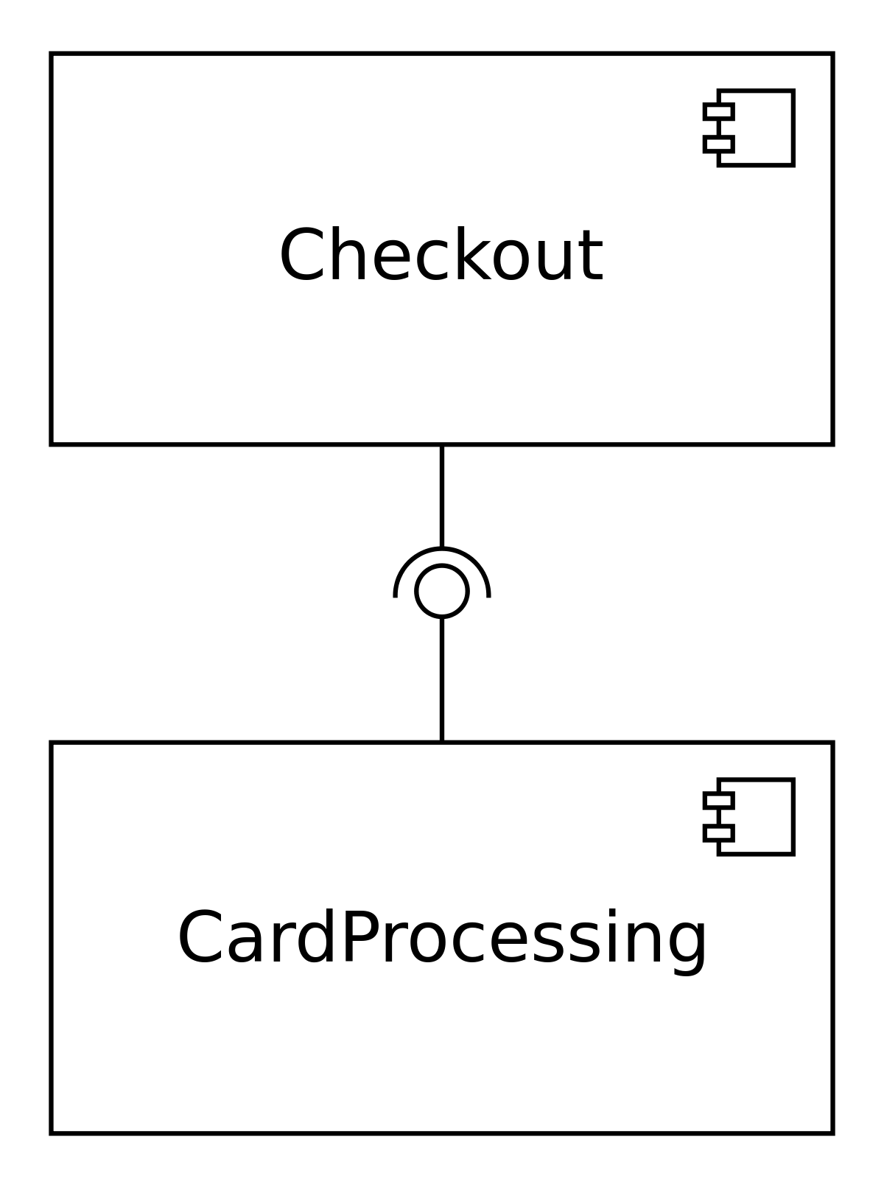

Unit tests: white or black box approach?
  Test possible paths?
  Test boundary values?
  Test exceptions?
  Is “inside knowledge” required?

Slide 11
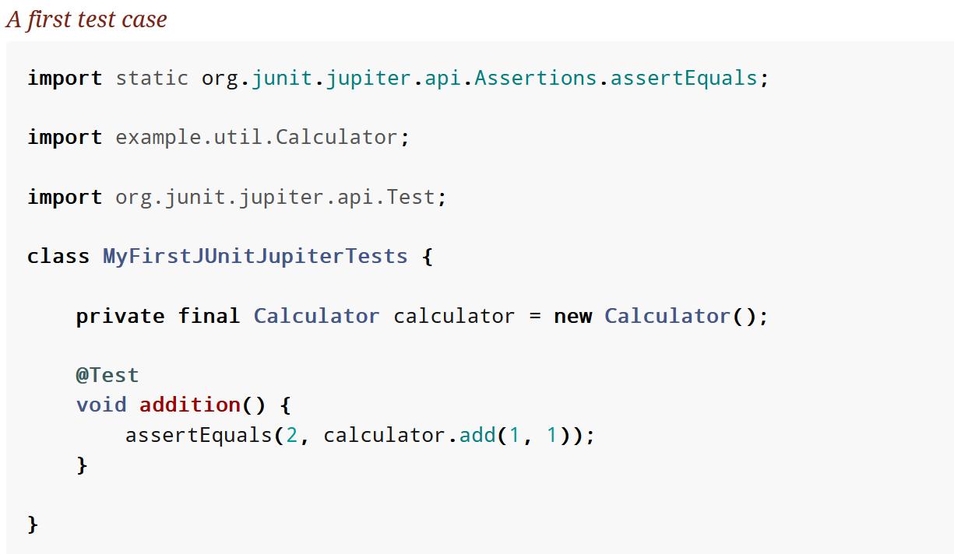
JUnit framework

Slide 12
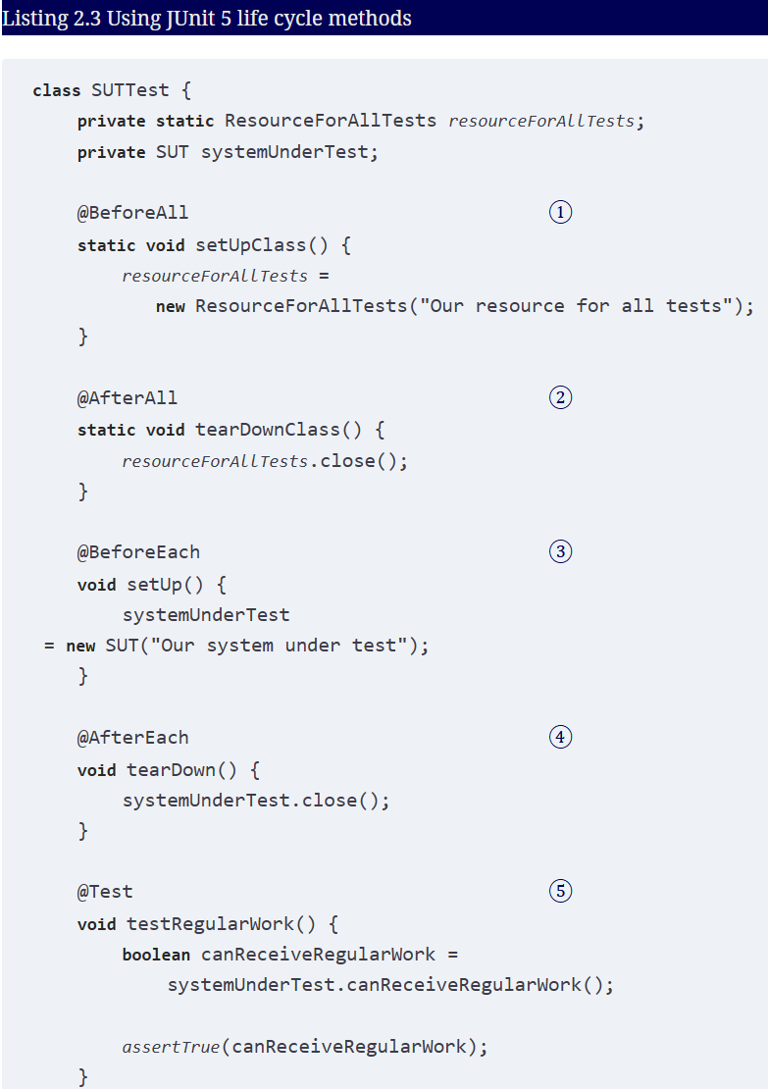
Lifecycle methods

Slide 13
Selected annotations
https://junit.org/junit5/docs/current/user-guide/#writing-tests-annotations
JUnit Annotation | Meaning
@Test | Denotes that a method is a test method.
@BeforeEach | The annotated method should be executed before each @Test
@AfterEach | The annotated method should be executed after each @Test
@ParameterizedTest | Denotes that a method is a test method. Can provide “data” to be used in the test execution.
@DisplayName | Declares a custom display name for the test class or test method.
@Disabled | [temporarily] Disable a test class or test method
…

Slide 14
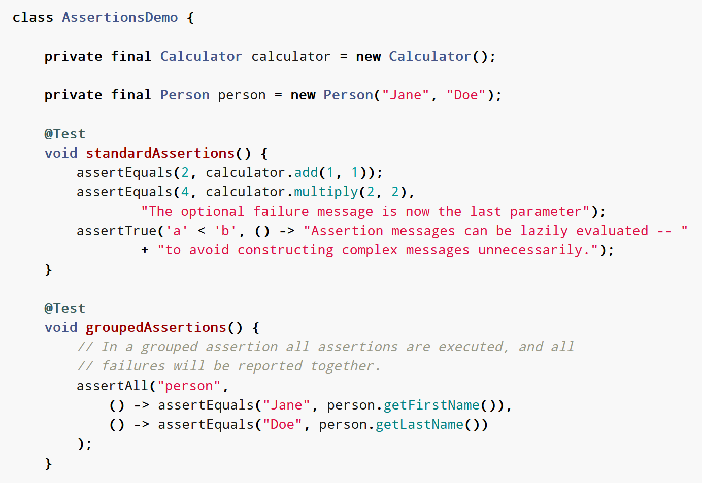
Assertions

Slide 15
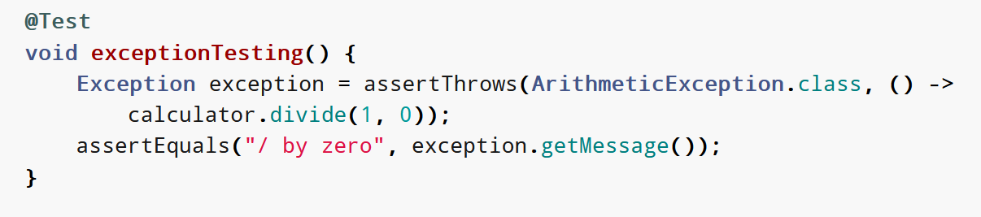
Testing for expected exceptions

Slide 16
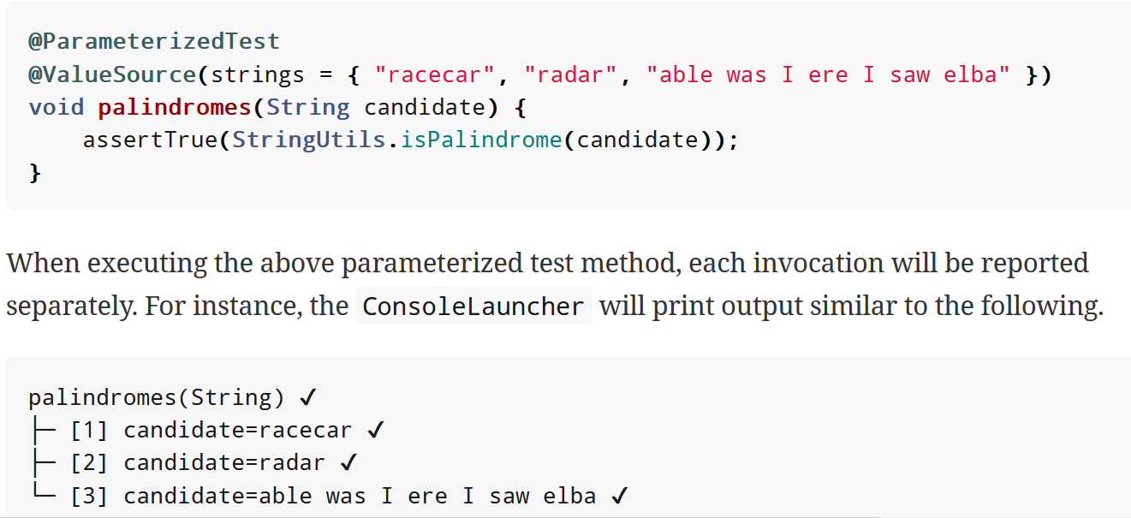
Parameterized tests

Slide 17
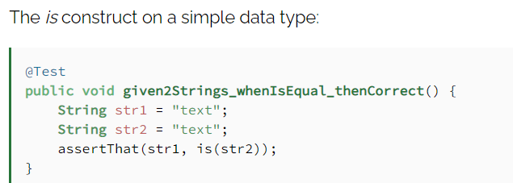
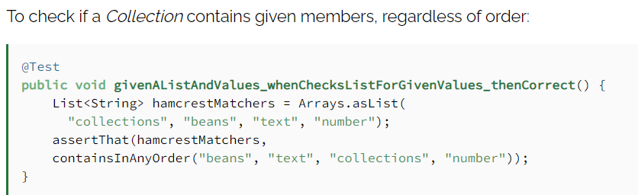
Assertions libraries: Hamcrest
https://hamcrest.org/JavaHamcrest/tutorial

Slide 18
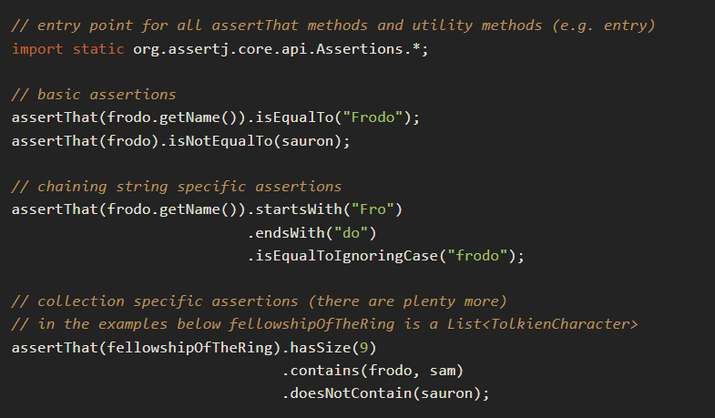
Assertions libraries: AssertJ
https://assertj.github.io/doc/

Slide 19
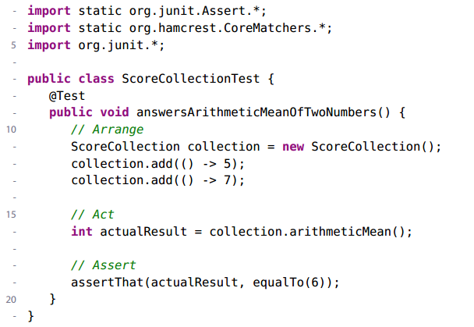
Keeping Tests Consistent with AAA
Arrange. Ensure that the system is in a proper state by creating objects, interacting with them, calling other APIs, and so on.
Act. Exercise the code we want to test, usually by calling a single method.
Assert. Verify that the exercised code behaved as expected. This can involve inspecting the return value or the new state of any objects involved. The blank lines that separate each portion of a test are a visual reinforcement to help you understand a test more quickly.
[ After. If running the test results in any resources being allocated, ensure that they get cleaned up. ]

Slide 20
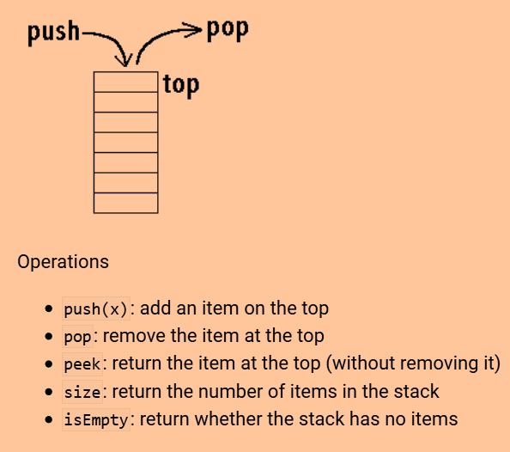
Unit test: stack contract

Slide 21
Unit test example: Verifying the unit contract
A stack is empty on construction
A stack has size 0 on construction
After n pushes to an empty stack, n > 0, the stack is not empty && its size is n
If one pushes x then pops, the value popped is x, the size is decreased by one.
If one pushes x then peeks, the value returned is x, but the size stays the same
If the size is n, then after n pops, the stack is empty and has a size 0
Popping from an empty stack does throw a NoSuchElementException
Peeking into an empty stack does throw a NoSuchElementException
For bounded stacks only, pushing onto a full stack does throw an IllegalStateException
→ See also: Ray Toal’s notes.

Slide 22
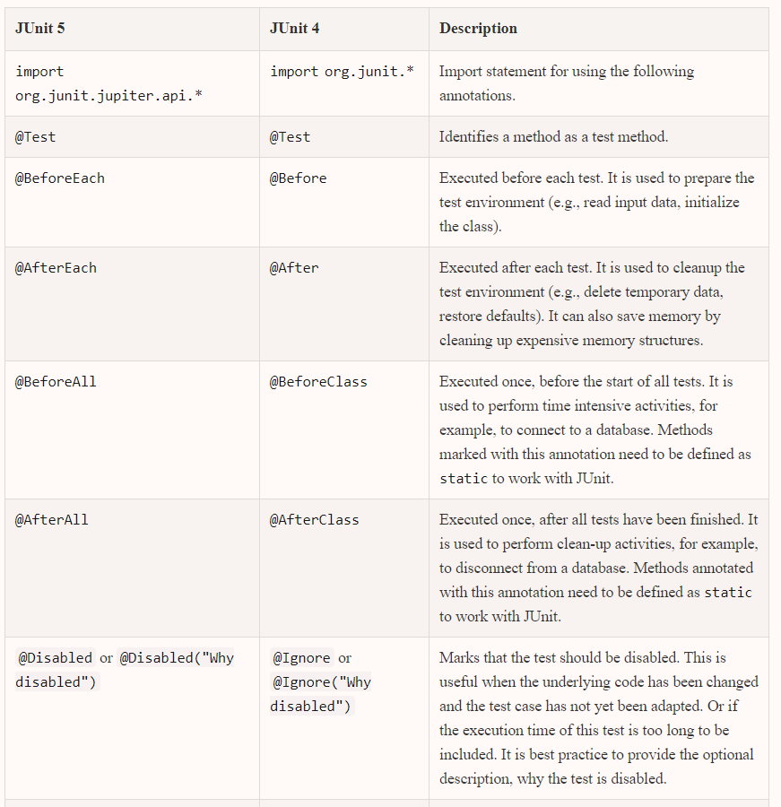


Slide 23
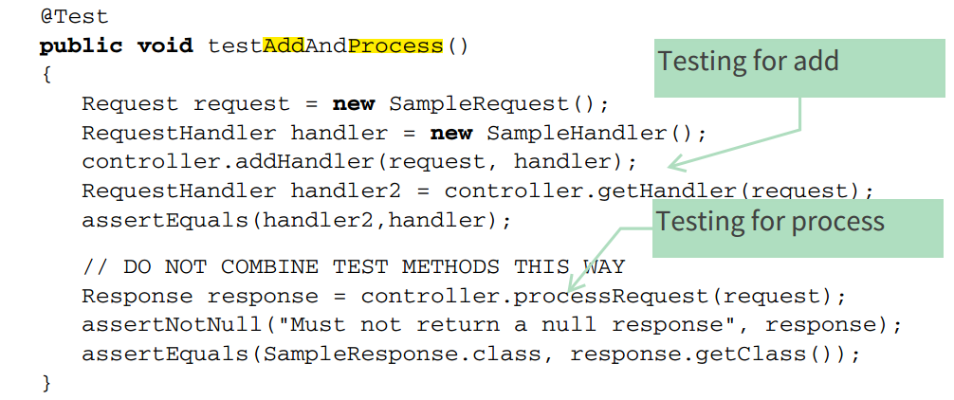
Anti-pattern: don’t combine test methods
One unit test equals one @Test method
  If you need to use the same block of code in more than one test, extract it into a utility
  if all methods can share the code, put it into the fixture.

Slide 24
Unit tests: properties of good tests
Automatic
  Can be run by an automation tool (vs. interactive)
Thorough/comprehensive
  Meets the desired coverage objectives (complete, careful)
  exercise the expected as well as the boundary/exceptional conditions
Repeatable
  able to be run repeatedly and continue to produce the same results, regardless of the environment (vs. hard-coded URL or IDs)
Independent
  Not depend or interfere with other tests
    you cannot rely upon one unit test to do the setup work for another unit test
  not guaranteed to run in a particular order

Slide 25
What not to test
Getters and setters
Framework code
  Specially generated code
Same conditions
  No point in having multiple tests for the same behavior or conditions
Complex behavior from collaborating objects
  that is not unit testing!

Slide 26
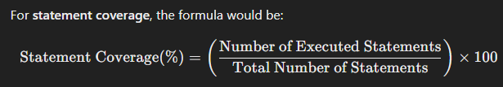
Code coverage
Implications of high/low values of coverage in the software reliability?
Code coverage as a quality metric
  measures the extent to which the source code of a program is executed/exercised when a particular test suite runs.
  helps developers assess test effectiveness, identify untested parts of the code
Different criteria:
  Statement Coverage – Measures the percentage of executed statements.
  Branch Coverage – Measures whether all possible branches (e.g., if and else conditions) have been executed.
  Function Coverage – Measures whether all functions or methods have been called.
  Path Coverage – Measures whether all possible execution paths have been traversed.
  Condition Coverage – Ensures that each boolean condition in decision-making constructs has been evaluated to both true and false.

Slide 27
Fault location techniques
FL: software debugging techniques to help developers understand which parts of the code are most likely responsible for causing test failures.
Spectrum-Based Fault Localization (SBFL) techniques use execution traces of test cases (=spectrum, as generated by Jacoco) to determine how likely specific program elements (e.g., statements) are responsible for observed failures.
SBFL techniques analyze how frequently different parts of the code participate in passing and failing test cases. By comparing the execution patterns, SBFL ranks code elements based on their likelihood of being faulty.
SBFL procedure:
Run the Test Suite:
Collect Execution Data: Track which statements or branches were executed during each test.
Compute Suspiciousness Scores: Use heuristics to compute how "suspicious" each
Rank Code Elements
Debugging and Fixing: investigate the most suspicious code elements first.

Slide 28
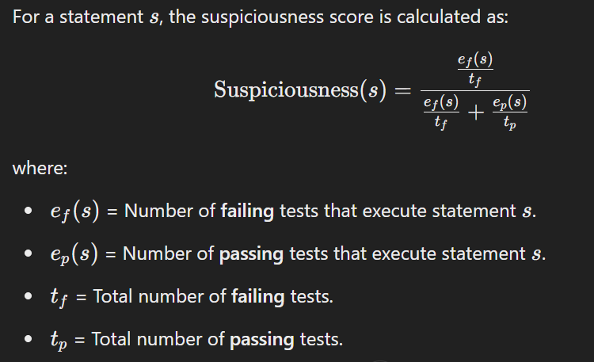
SBFL heuristic: Tarantula
T. assigns a suspiciousness score to each statement based on how often it is executed in failing vs. passing tests.
One of the most used in software methods research for benchmarking

Slide 29


Slide 30

References
Titles from Oreilly are available to UA’s students
    Log with SSO providing your @ua.pt email
    JUnit in Action

